Slide 1


Intro to MATLAB Programming – Lesson 2

Slide 2


How Do Machines Learn?
First, we will watch a short 3-minute video that introduces the concept of machine learning, please click on the following link to the MathWorks website:
Machine Learning Fundamentals | Introduction to Machine Learning, Part 1 - MATLAB & Simulink (mathworks.com)
What applications in everyday life would benefit from having Machine Learning as a tool?

Slide 3



How Do Machines Learn?
Let’s discuss the following questions:
What are the common scenarios where machine learning is applied? Have you encountered any of these applications in their daily lives? Examples: Netflix and Spotify recommendations systems, social media, image recognition in phones, traffic predictions from Google Maps, etc.
According to the video what are the two main learning techniques employed by machine learning? How are these similar or different to how people learn?

Slide 4
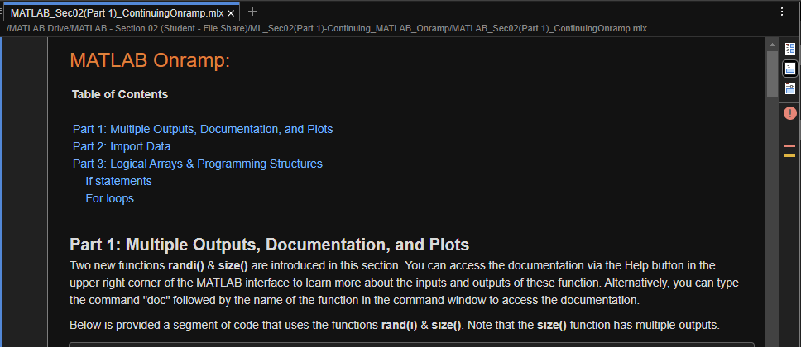
Continuing With MATLAB Onramp
Please copy over the files for Section 02 from the MATLAB Drive
The MATLAB files for this section can be found at this link here.
Notes:
The URL on this slide is for the student version of the files, please see the teacher guide for the teacher version of the files You can also find the teacher and student links on the master document with all the youtube video and matlab drive links for every section on it

Slide 5
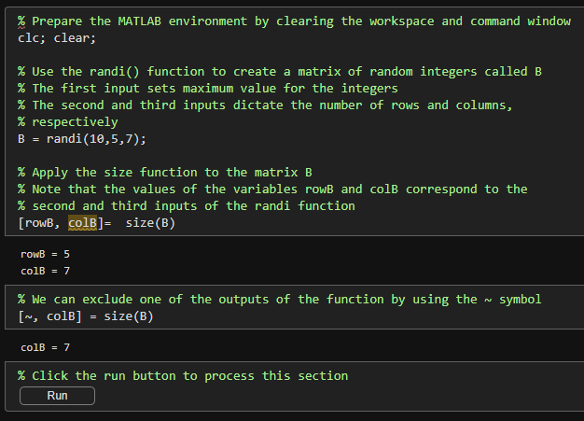
Continuing With MATLAB Onramp
Part 1: Multiple Outputs, Documentation, and Plots
Two new functions randi() & size() are introduced in this section.
You can access the documentation via the Help button in the upper right corner of the MATLAB interface to learn more about the inputs and outputs of these function.
Alternatively, you can type the command "doc" followed by the name of the function in the command window to access the documentation.
The segment of code to the right uses the functions rand(i) & size(). Note that the size() function has multiple outputs.

Slide 6
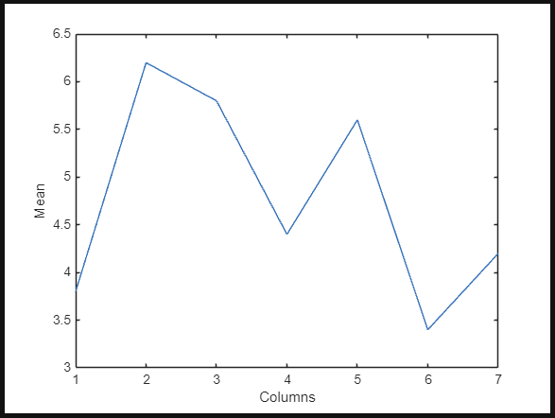
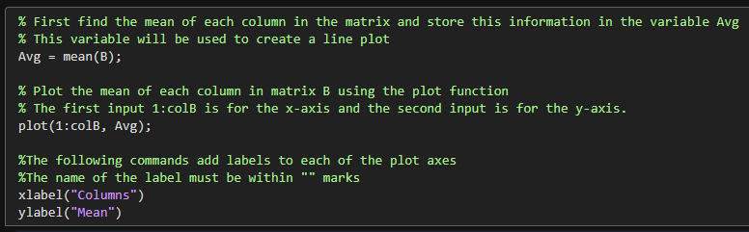
Continuing With MATLAB Onramp
Part 1: Multiple Outputs, Documentation, and Plots
We can use the matrix we generated with the randi() function to create a simple plot.
The plot is created and formatted using the plot(), title(), xlabel(), and ylabel() commands:
Since we are using the function randi() to generate a matrix with random values, the shape of the plot will always be different when the code is re-ran.

Slide 7
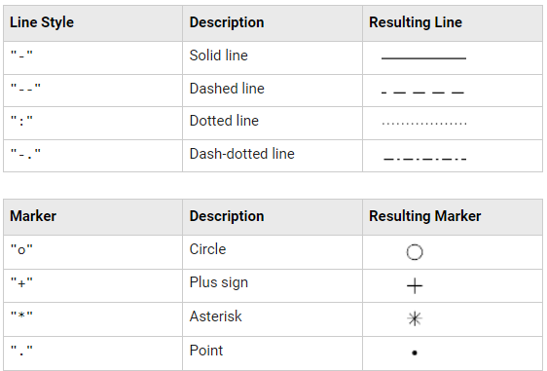
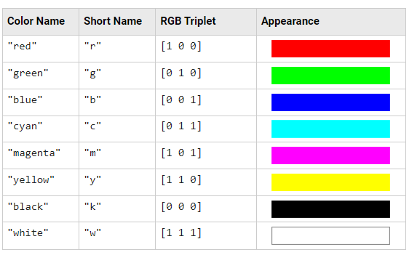
Continuing With MATLAB Onramp
Part 1: Multiple Outputs, Documentation, and Plots
The documentation for the plot() function reveals different ways to change the appearance of the plot.
Specifically, the plot() function can change the color of the line, the width of the line, and the linestyle. The tables below show some commonly used inputs:

Slide 8
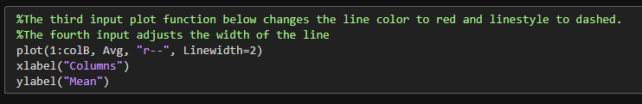
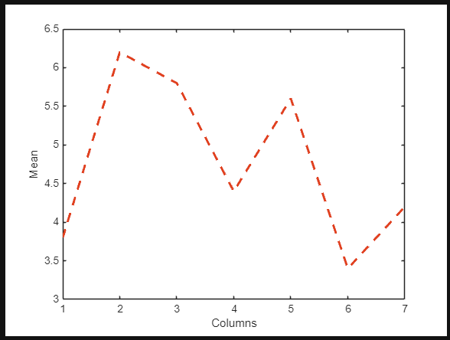
Continuing With MATLAB Onramp
Part 1: Multiple Outputs, Documentation, and Plots
Let's use some of these parameters to change the style/appearance of the plot:

Slide 9
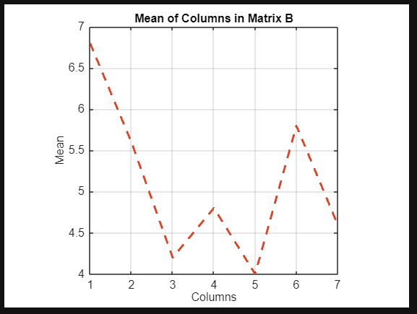
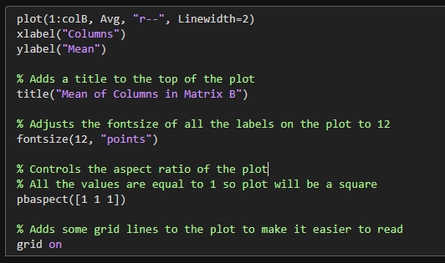
Continuing With MATLAB Onramp
Part 1: Multiple Outputs, Documentation, and Plots
Let's continue to adjust the plot by adding a title, making the font size 12, and changing the aspect ratio of the plot.
Also, add a grid to the plot using the grid on command.

Slide 10
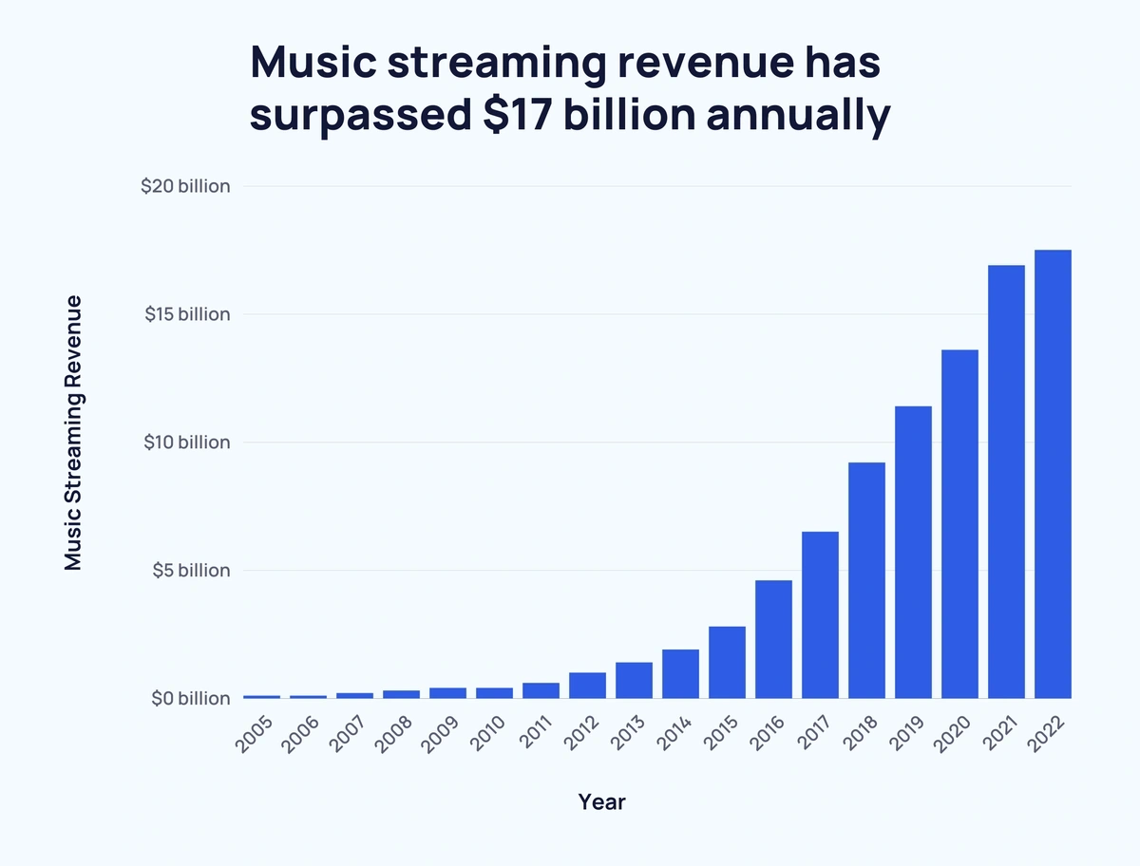
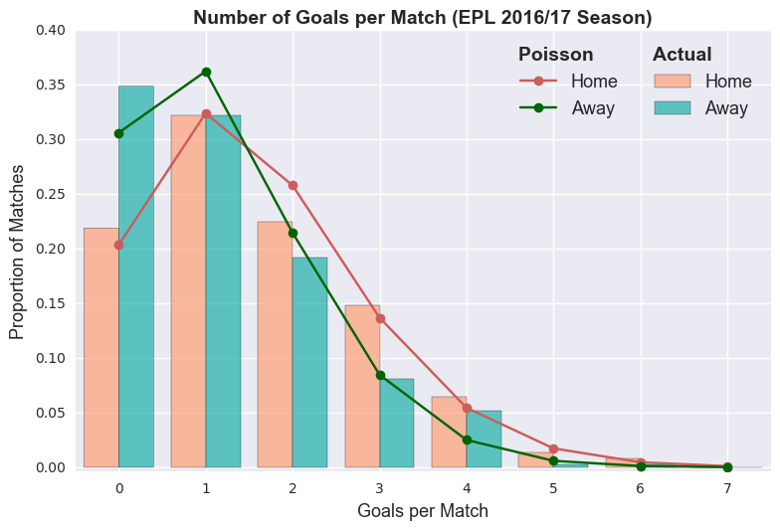
Continuing With MATLAB Onramp
Part 1: Multiple Outputs, Documentation, and Plots
Let’s Discuss!
If we wanted to create plots about artists and athlete data, what data might we use?
How might plots be helpful when trying to explain the importance of our data or conclusions from our AI tool?
Source: https://explodingtopics.com/blog/music-streaming-stats
Source: https://dashee87.github.io/football/python/predicting-football-results-with-statistical-modelling/

Slide 11
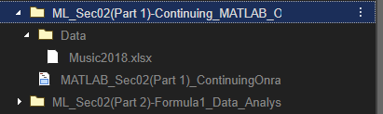
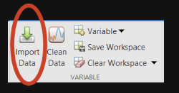
Continuing With MATLAB Onramp
Part 2: Import Data
Let's learn how we can import real-world data to create plots in order to make some inferences and conclusions based on our data.
Make sure you have the data file 'Music2018.xlsx' for this section in the same folder as your live script (or if you are in the MATLAB Drive, it will be in the Data folder and you do not need to move it).
You can import data into MATLAB by using the "Import Data" button under the HOME tab.

Slide 12
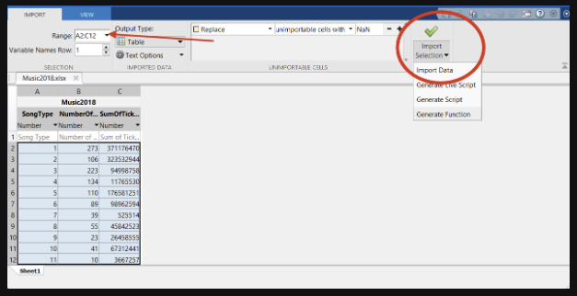
Continuing With MATLAB Onramp
Part 2: Import Data
The “Import Data” button allows the user to extract data from MATLAB compatible files stored on their device.
Selecting a file opens a window like the one shown below. In this window, the user can adjust the range of the data extracted and change the data output type.
To import the selected data the user can use the “Import Selection” button.
The imported data is stored in a variable that appears in the workspace. Once the variable is in the workspace the user can access the data to use in the code.

Slide 13
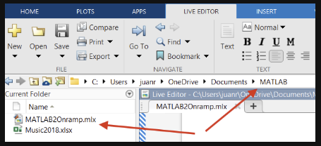
Continuing With MATLAB Onramp
Part 2: Import Data
Another way to access data in MATLAB compatible files is to make sure that the file is in the same folder as your MATLAB live script.
You can then use the readtable() function to import tabular data from a spreadsheet or text file and store the data in variable.
We can then store the data from this file in a table variable using the code below:

Slide 14
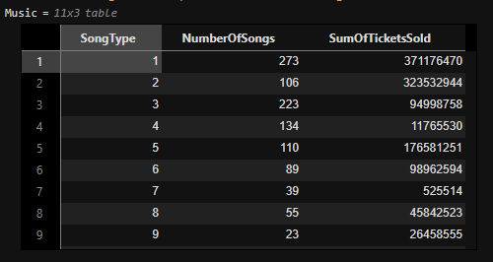
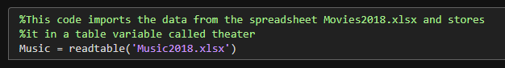
Continuing With MATLAB Onramp
Part 2: Import Data
After we use readtable() you should see the table printed out below (or to the right) of your cell:
If you did not grab the entire folder for this section from the MATLAB Drive, and instead your files were downloaded individually, you may have your data file in the same folder as your live script.
In that case your filepath for the data would look like this instead.

Slide 15
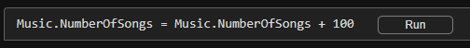
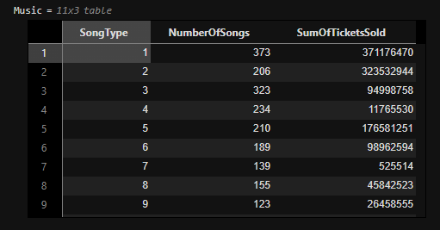
Continuing With MATLAB Onramp
Part 2: Import Data
We can use dot notation to refer to any individual variable within a table.
We can also use dot notation to extract, modify, and reassign variables in a table.
For example, the code below adds 100 to each value the in the NumberOfSongs column of the table .
When would making edits to an entire column be useful?
What if a column was a unit of time like days and you wanted it in hours or weeks?

Slide 16
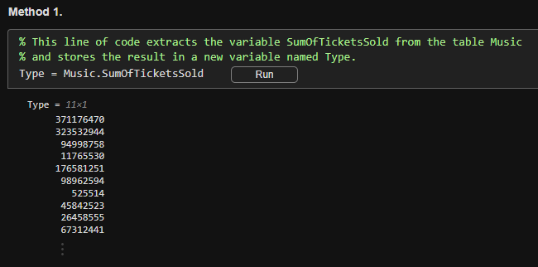
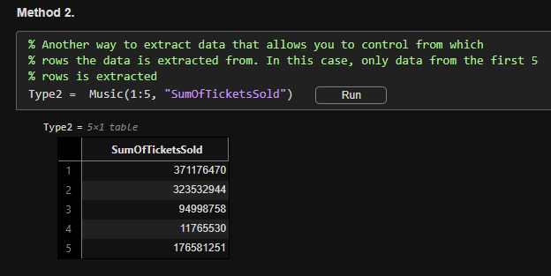
Continuing With MATLAB Onramp
Part 2: Import Data
We can also store individual columns from the table as variables, here are a couple ways to do this:

Slide 17


Continuing With MATLAB Onramp
Part 2: Import Data
Let’s Discuss!
How would MATLAB make it easy to manage large amounts of data for applications in either music or sports? (athlete data, song data, etc.)
If you were given data on athletes that had a column for number of games and a column for total score, how would you find the average score per game of each player?

Slide 18
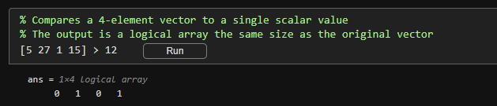
Continuing With MATLAB Onramp
Part 3: Logical Arrays & Programming Structures
Coding logic and control structures are important features that allow us to control the flow of our programs and make comparisons that can allow us to make choices such as running a certain piece of our code or skipping it.
Relational operators, such as >, <, ==, and ~= perform comparisons between two values.
The outcome of a comparison for equality or inequality is either 1 (true) or 0 (false). When comparing an array to a single scalar value the output is a logical array of ones and zeros.
Here is an example of comparing a single integer to an array of integers, which gives us an array of true and false values (1s and 0s):

Slide 19
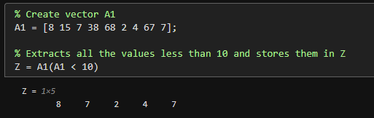
Continuing With MATLAB Onramp
Part 3: Logical Arrays & Programming Structures
A logical array can be used as an array index, so that MATLAB extracts the array elements where the corresponding index is 1 (true).
This example extracts all elements of that are less than 10 from the vector A1:

Slide 20
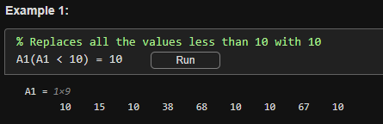
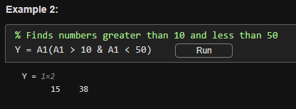
Continuing With MATLAB Onramp
Part 3: Logical Arrays & Programming Structures
Logical Indexing can be used to reassign values in an array. It is also possible to combine logical comparisons by using the logical operators AND (&) and OR (|):

Slide 21



Continuing With MATLAB Onramp
Part 3: Logical Arrays & Programming Structures
Let’s Discuss!
When would using a logical array or filter be useful for sorting sports data? Could we use this to narrow down the worst or best players/teams?

Slide 22
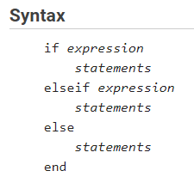
Continuing With MATLAB Onramp
Part 3: Logical Arrays & Programming Structures
If statements
One useful application of relational operators and logical arrays is in programming structures such as if statements and for loops.
If statements allow you to perform conditional execution, where code is only executed when specific conditions are true. The basic syntax is shown below:

Slide 23
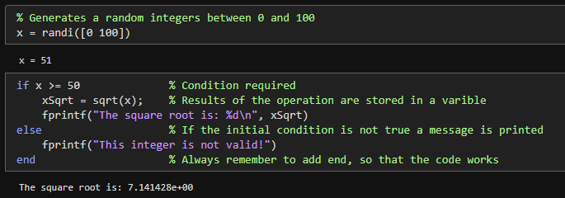
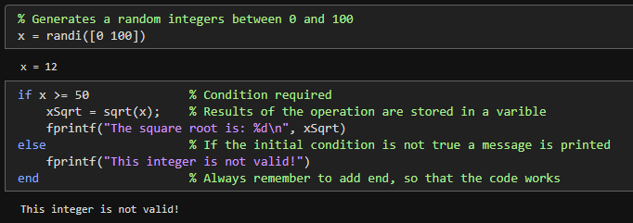
Continuing With MATLAB Onramp
Part 3: Logical Arrays & Programming Structures
If statements
Below is a basic example of an if statement that takes the square root of an integer only if its greater than 50.
Run this section of code multiple times to see if the code works properly.

Slide 24
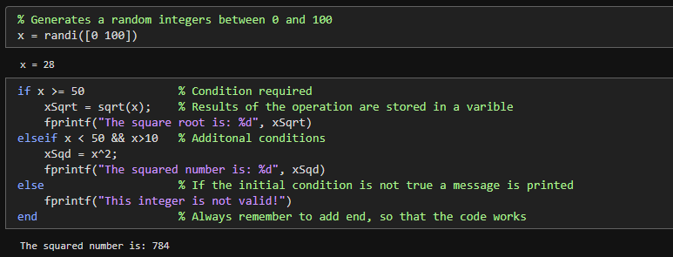
Continuing With MATLAB Onramp
Part 3: Logical Arrays & Programming Structures
More complexity can be add to the if statement above by including elseif statements.
Elseif statements allow you to check for more conditions and there is no limit to how many elseif statements you can incorporate.
Let’s add another condition to the example above. If the number is less than 50 and greater than 10 it will be squared:

Slide 25
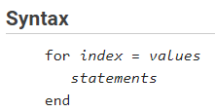
Continuing With MATLAB Onramp
Part 3: Logical Arrays & Programming Structures
For Loops
For loops are used when you want to repeat a task for a specific number of times. Its syntax is shown below:
The index is written in the form of a row vector, and it dictates how many times the statements are executed.
For example, the index 1:25 will start at 1 and increase by 1 after each execution until it reaches 25, so the loop will be executed 25 times.

Slide 26
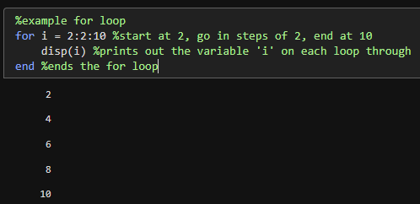
Continuing With MATLAB Onramp
Part 3: Logical Arrays & Programming Structures
For Loops
Example: How many runs will a for loop with the index 2:2:10 execute?
The index will start out at 2 and increase by 2 until it reaches 10. Therefore, the resulting vector will be [2 4 6 8 10].
The vector contains 5 elements, so the for loop will be executed 5 times.

Slide 27
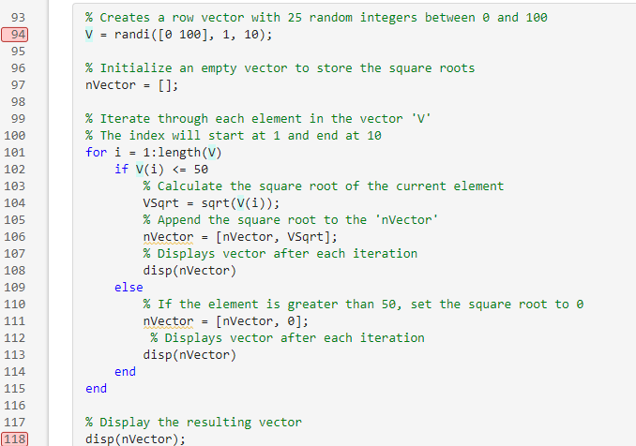
Continuing With MATLAB Onramp
Part 3: Logical Arrays & Programming Structures
For Loops and If Statement Example Using “Step”
The coding example below incorporates a for loop and if statements to calculate the square root of a number less than or equal to 50 and store it in a new vector.
Use the step through capability in MATLAB to visualize how the code works.
In the workspace see how the variable nVector is changing after each iteration.
To step through the code click the numbers corresponding to the first and last lines of the code segment to make them red.
Then click the "Run Section" button and use the "Step" button to step through each line of code one at a time.

Slide 28
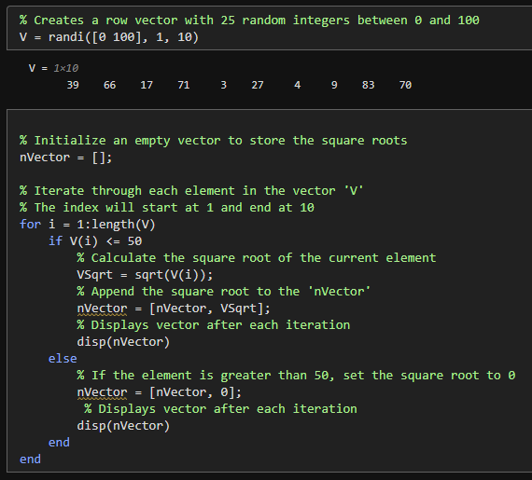
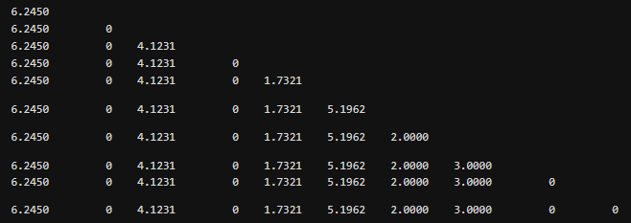
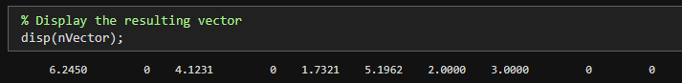
Continuing With MATLAB Onramp
Part 3: Logical Arrays & Programming Structures
Example Code:
Output:
Here is what is saved in the variable “nVector” after the loop completes:

Slide 29
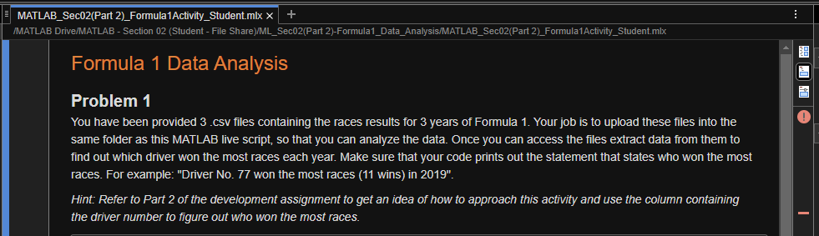
Formula 1 Data Analysis
The file for this assignment is also in the MATLAB Drive, as “Part 2”, please open and complete the activity.
The MATLAB files for this section can be found at this link here.
Notes:
The URL on this slide is for the student version of the files, please see the teacher guide for the teacher version of the files You can also find the teacher and student links on the master document with all the youtube video and matlab drive links for every section on it

Slide 30
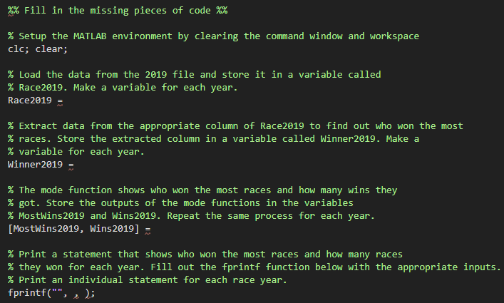
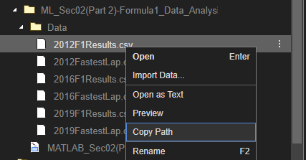
Formula 1 Data Analysis
Hint: Refer to Part 2 of the previous live script to get an idea of how to approach this activity and use the column containing the driver number to figure out who won the most races.
Problem 1
You have been provided 3 .csv files containing the races results for 3 years of Formula 1.
Your job is to extract data from them to find out which driver won the most races each year. Make sure that your code prints out the statement that states who won the most races.
For example: "Driver No. 77 won the most races (11 wins) in 2019".
You can use “copy path” by right clicking the file to get the .csv path for the readtable() function.
Notes:
Next slide shows an example filepath copied from the files tab

Slide 31
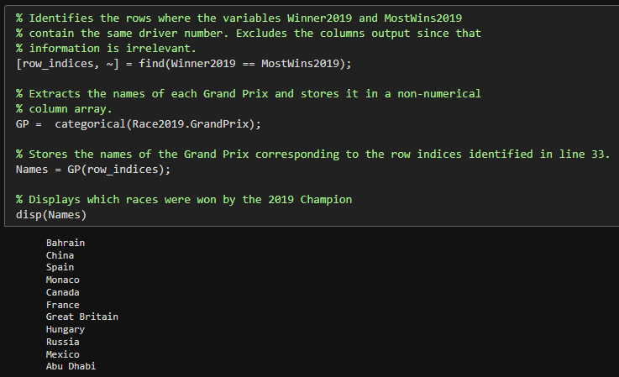
Formula 1 Data Analysis
Problem 1 (Extra)
If you wanted to know what races were won by the driver that won the most races in 2019 you could use the code block to the right:
You can use “copy path” by right clicking the file to get the .csv path for the readtable() function.

Slide 32
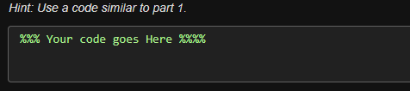
Formula 1 Data Analysis
Problem 1 (Part 2)
Part 2
You been provided 3 files showing which driver set the fastest lap each race for the 2012, 2016, and 2019 seasons.
Write a code that can find out which driver got the fastest lap awards and show where they had their fastest laps.

Slide 33
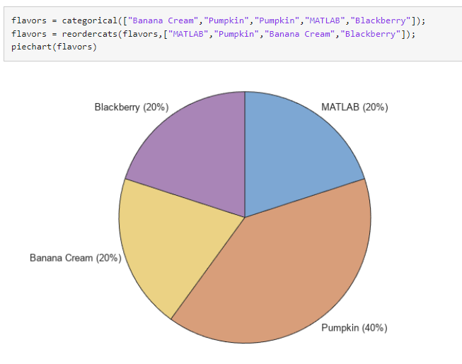
Formula 1 Data Analysis
Problem 2 (Part 1)
Part 1
Continue to use the .csv file containing the race results for 2019 from Problem 1 and present the race winner results in the form of pie chart.
Mark sure to add an appropriate title to your plot.
An example pie chart with code from the MATLAB documentation is shown to the right:

Slide 34
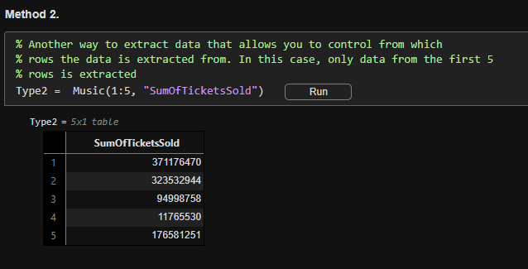
Formula 1 Data Analysis
Problem 2 (Part 2)
Part 2
Write code that a Formula 1 team could use to only analyze the races from the first half of the season.
Based on this data who would be the expected winner each year.
Make sure your code prints out a statement with the expected winner.
Hint: Recall the syntax used in the development activities to extract data from only the desired rows and columns (to the right).

Slide 35
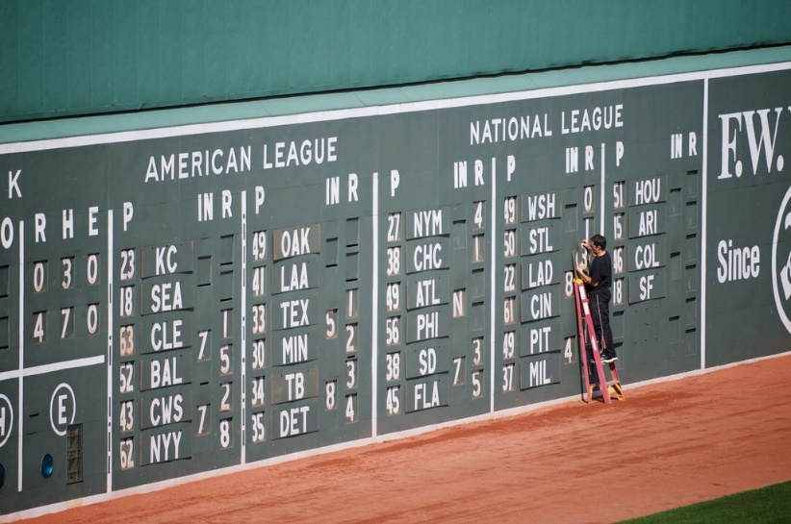
How Can Machines Learn About Sports?
The data import practice problems reveal that the driver that wins a race is not necessarily the fastest driver during the race.
For example, Lewis Hamilton (No. 44) who won 11 races in 2019 only got 6 fastest lap awards that same year.
Therefore, a program designed to predict who is the next F1 Champion cannot simply rely on who is the fastest.
Knowing this, discuss and answer the following in groups:
What types of data can Formula 1 teams use to make a machine learning model more accurate?
Are there variables that cannot be accounted for (e.g. car breakdowns, injuries)?

